Slide 1

Firebase integration

Slide 2
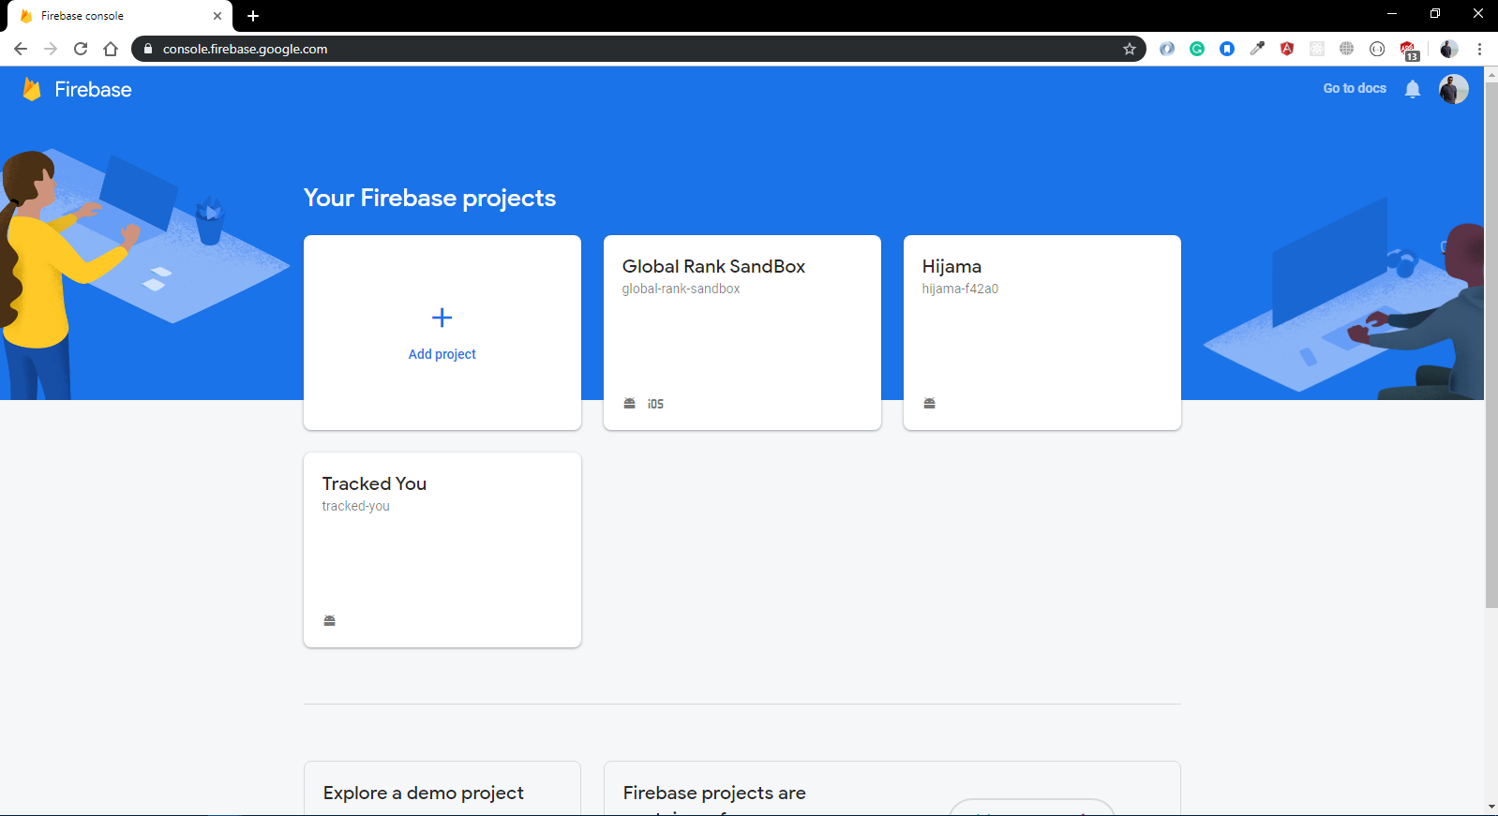
Integration(1/3)
Step 1:
Open Firebase Console
Step 2:
Add project

Slide 3
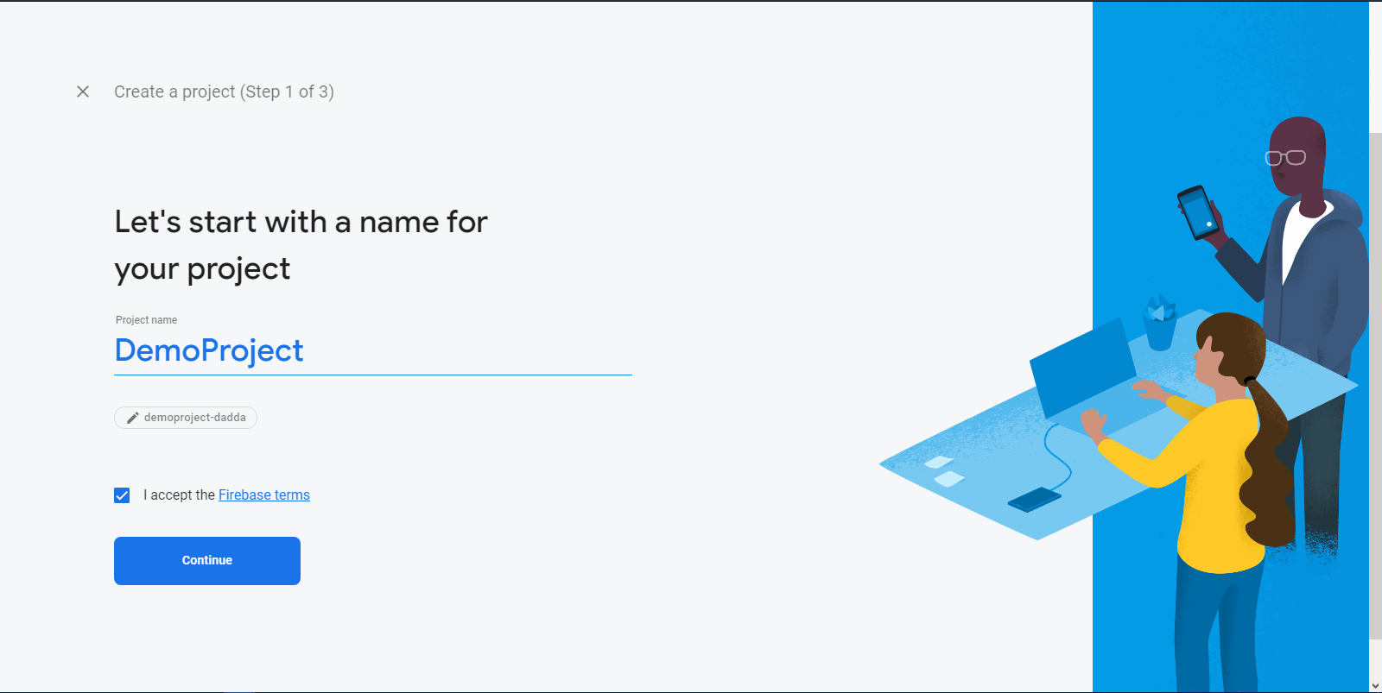
Integration(2/3)
Step 3:
Add Project Name
Step 4:
Check firebase terms
Step 5:
Continue

Slide 4
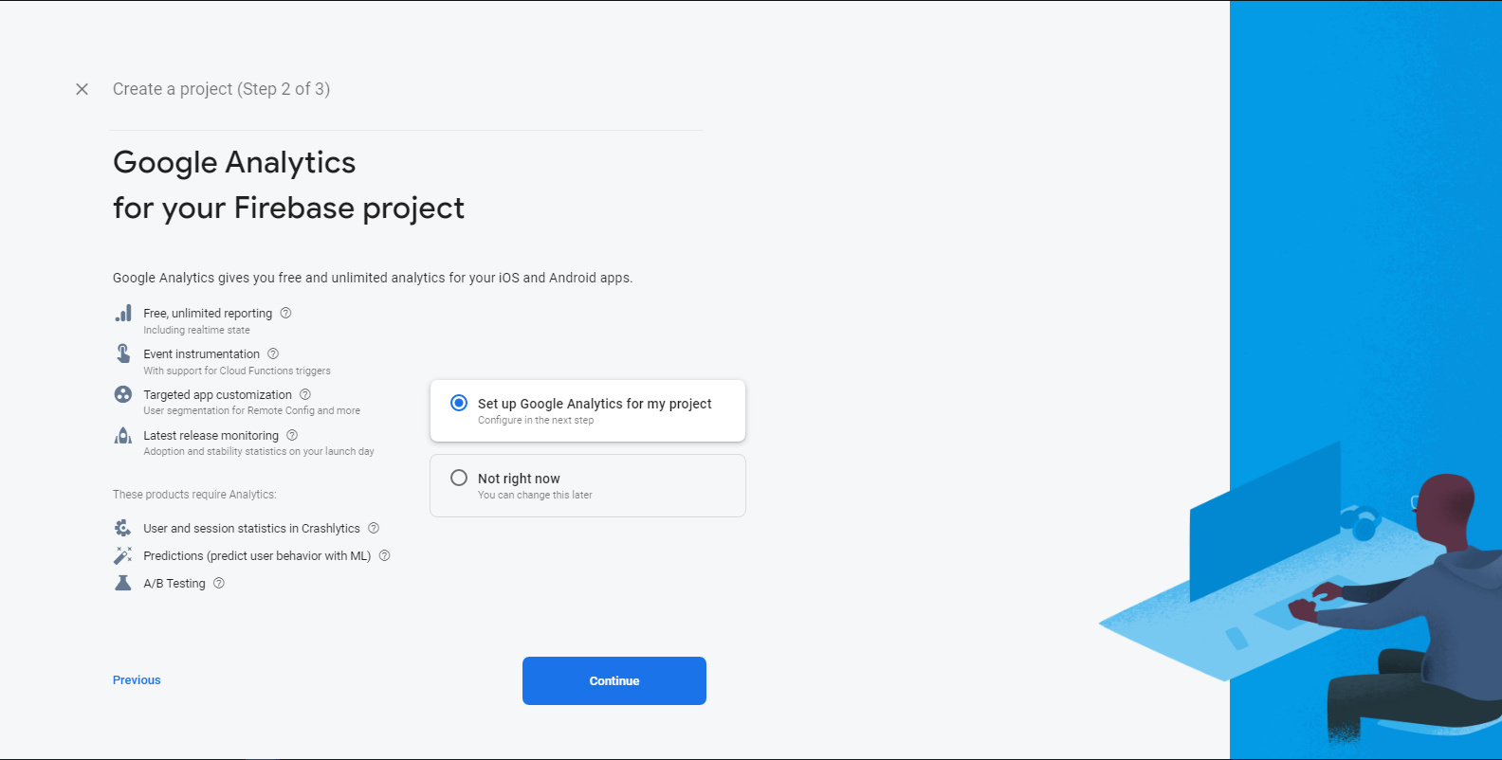
Integration(3/3)
Step 6:
Either You can skip or setup
(I’m gonna skin this Google Analytics part)
Step 7:
Click Not right now
Step 8:
Create project

Slide 5
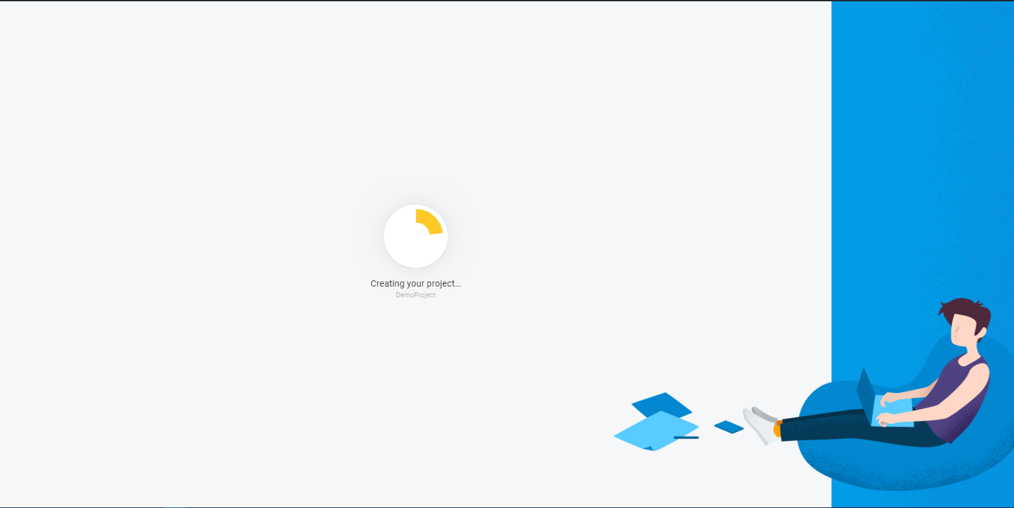
Project is creating

Slide 6
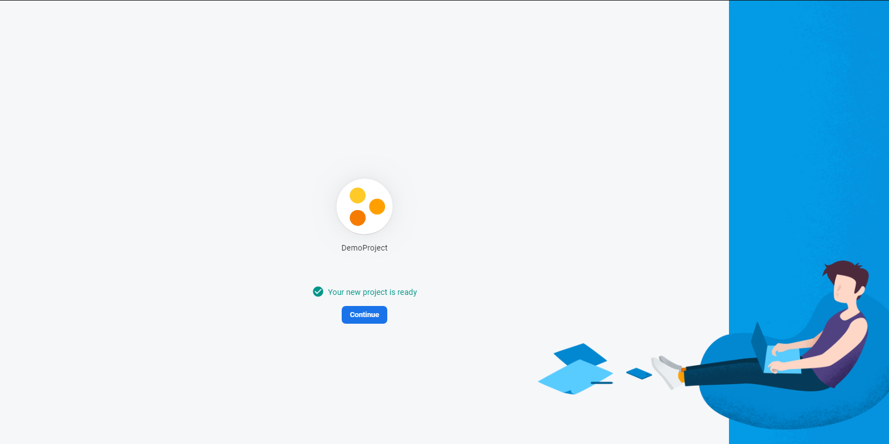
Project has created

Slide 7
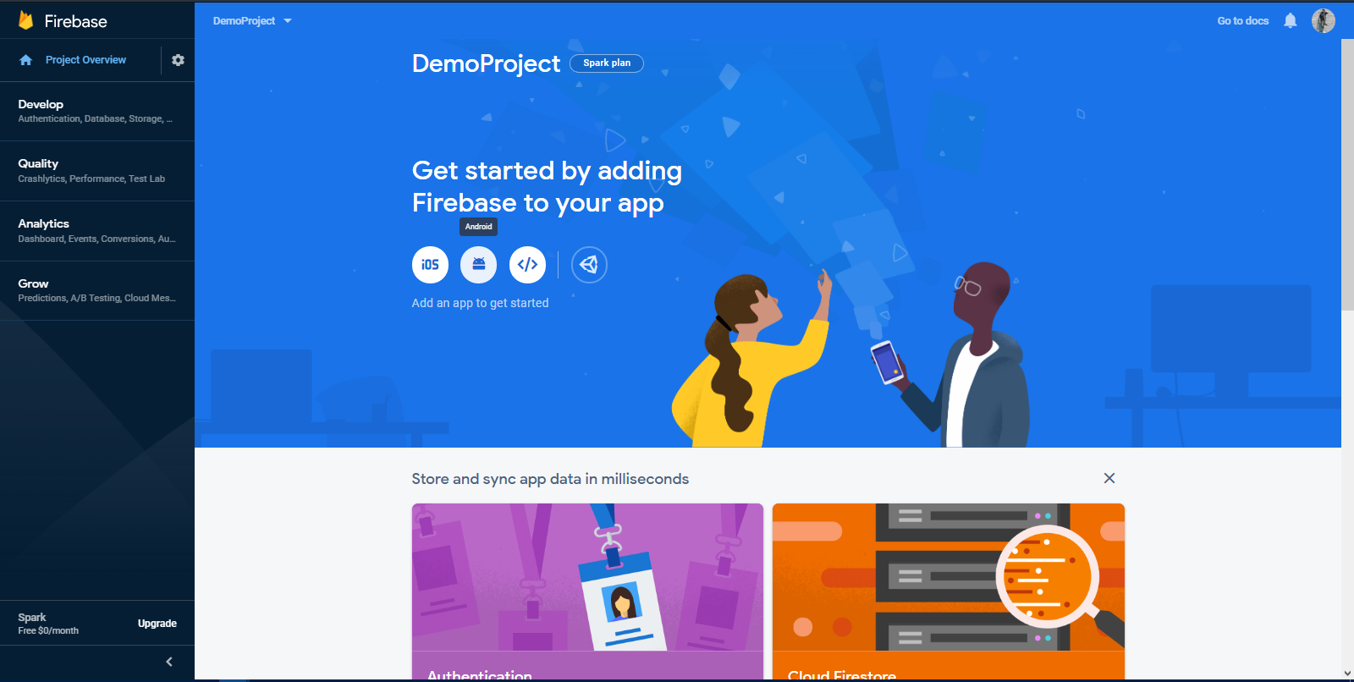
Firebase dashboard(1/8)
Step 1:
Click on android

Slide 8
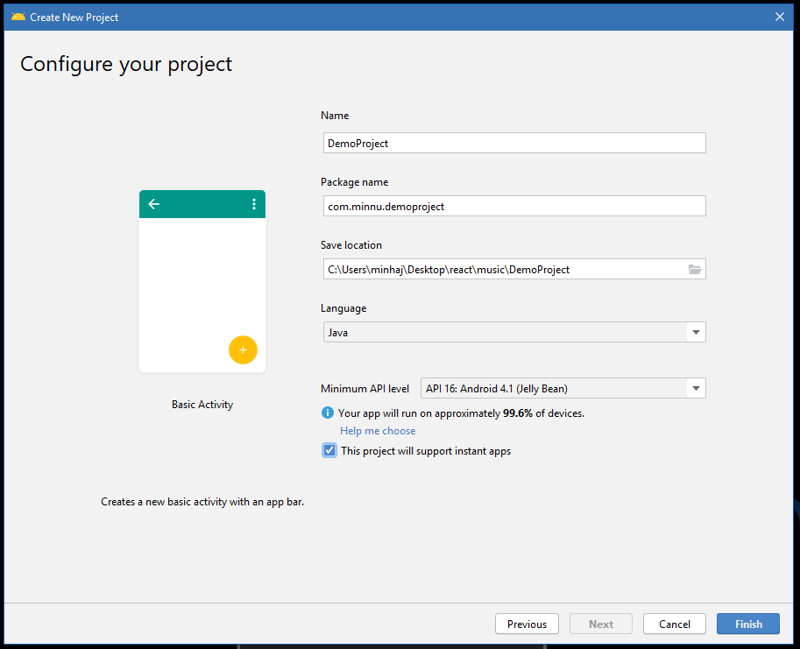
Firebase dashboard(2/8)
Step 2:
Create new android project
Step 3:
Copy package name

Slide 9
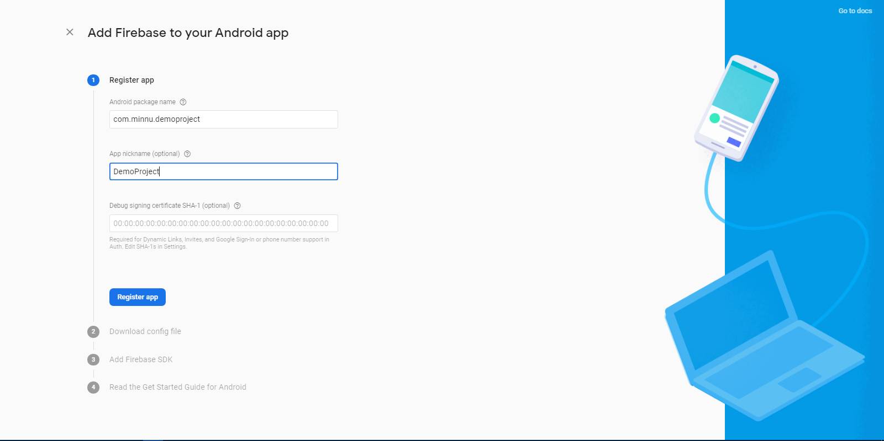
Firebase dashboard(3/8)
Step 4:
Paste android package name
Step 5:
Add Android Project Name
Step 6:
Skip SHA-1 Hash key part- Register app

Slide 10
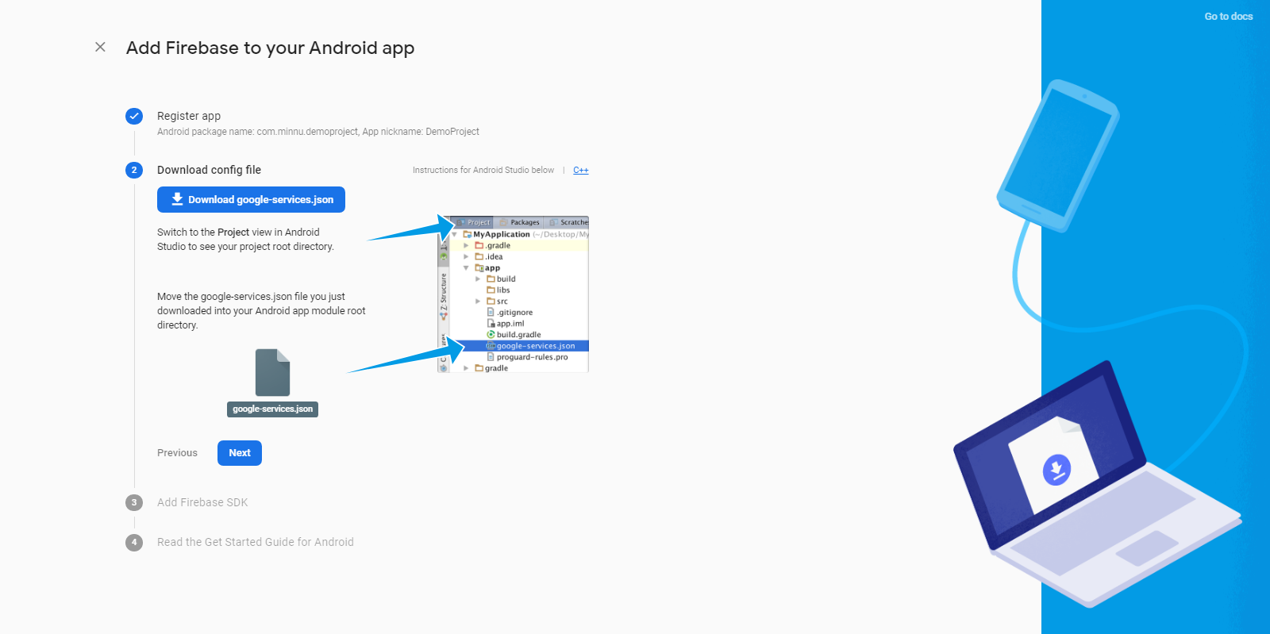
Firebase dashboard(4/8)
Step 7:
Download google-service json

Slide 11
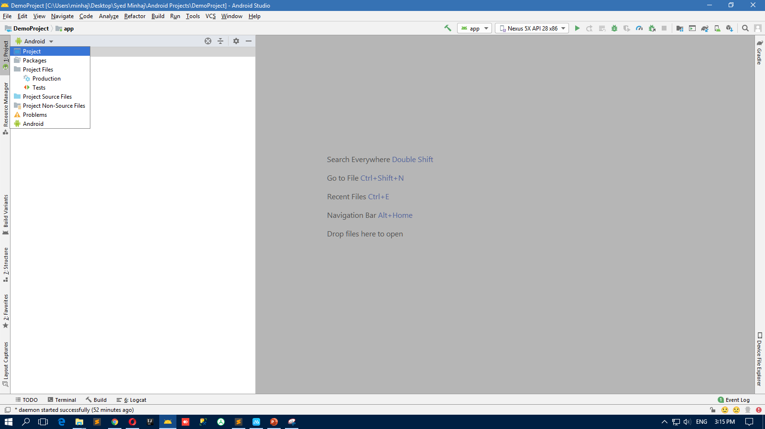
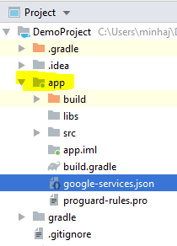
Firebase dashboard(5/8)
Step 8:
Change structure android to project, here you can easily find app folder just in.

Slide 12
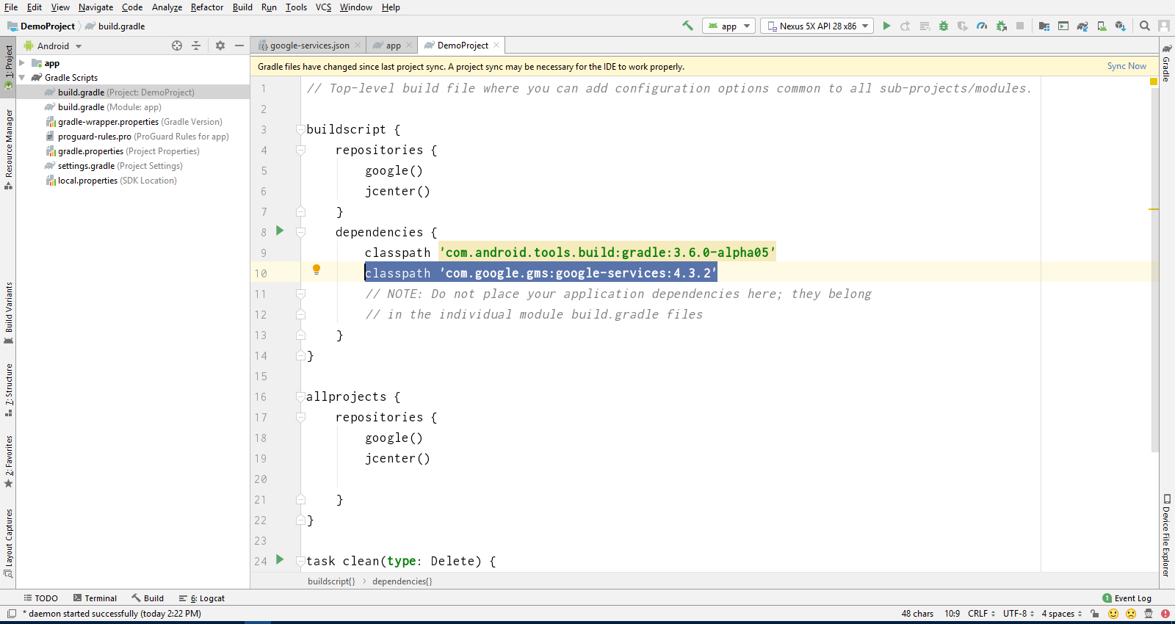
Firebase dashboard(6/8)
Step 9:
Open build.gradle
Add this line inside dependencies
Step 10:
Add dependency to project level

Slide 13
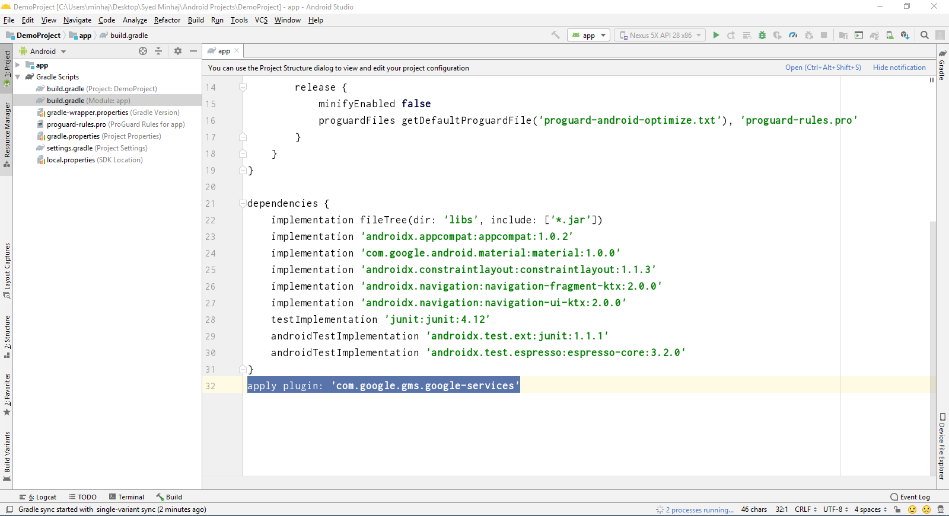
Firebase dashboard(7/8)
Step 11:
Open build.gradle
Step 12:
Add this line to the bottom of the file

Slide 14
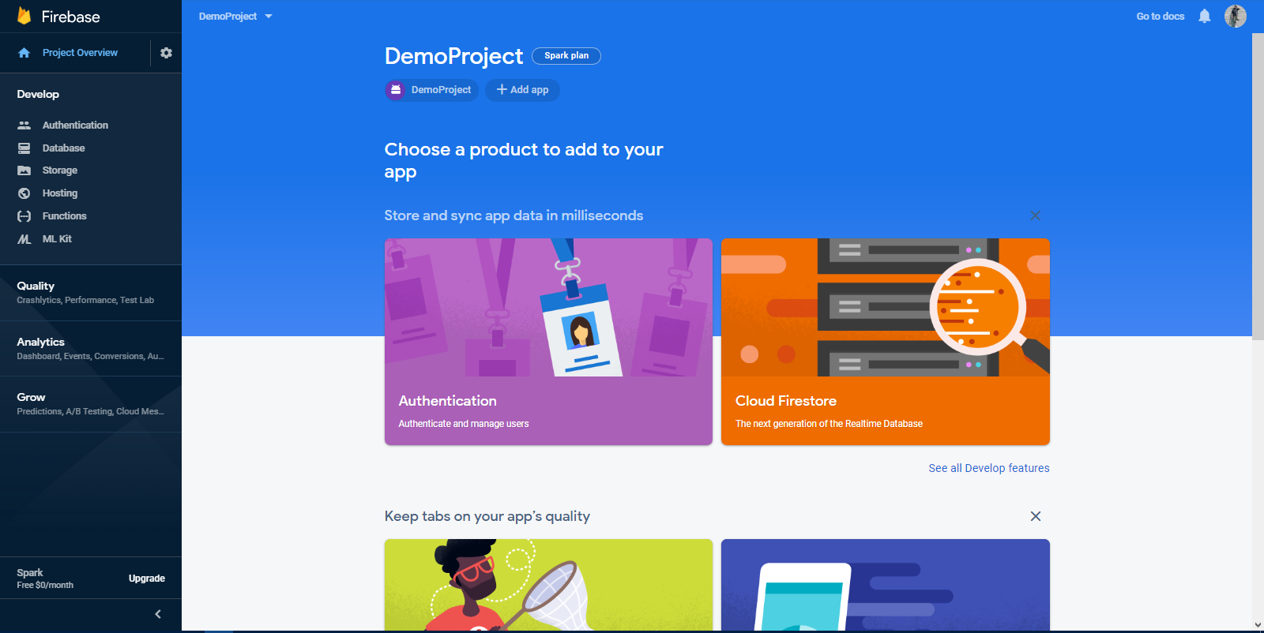
Firebase dashboard(8/8)
Firebase Dashboard

Slide 15
Realtime Database
All Firebase Realtime Database data is stored as JSON objects. You can think of the database as a cloud-hosted JSON tree. Unlike a SQL database, there are no tables or records. When you add data to the JSON tree, it becomes a node in the existing JSON structure with an associated key.

Slide 16
Thank You

